Slide 1
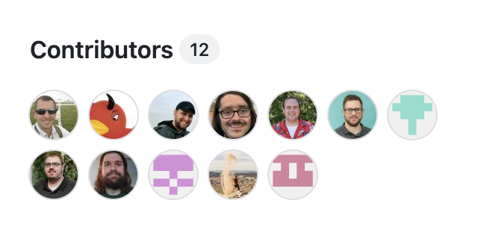
Atmospheric data Community Toolkit

Slide 2
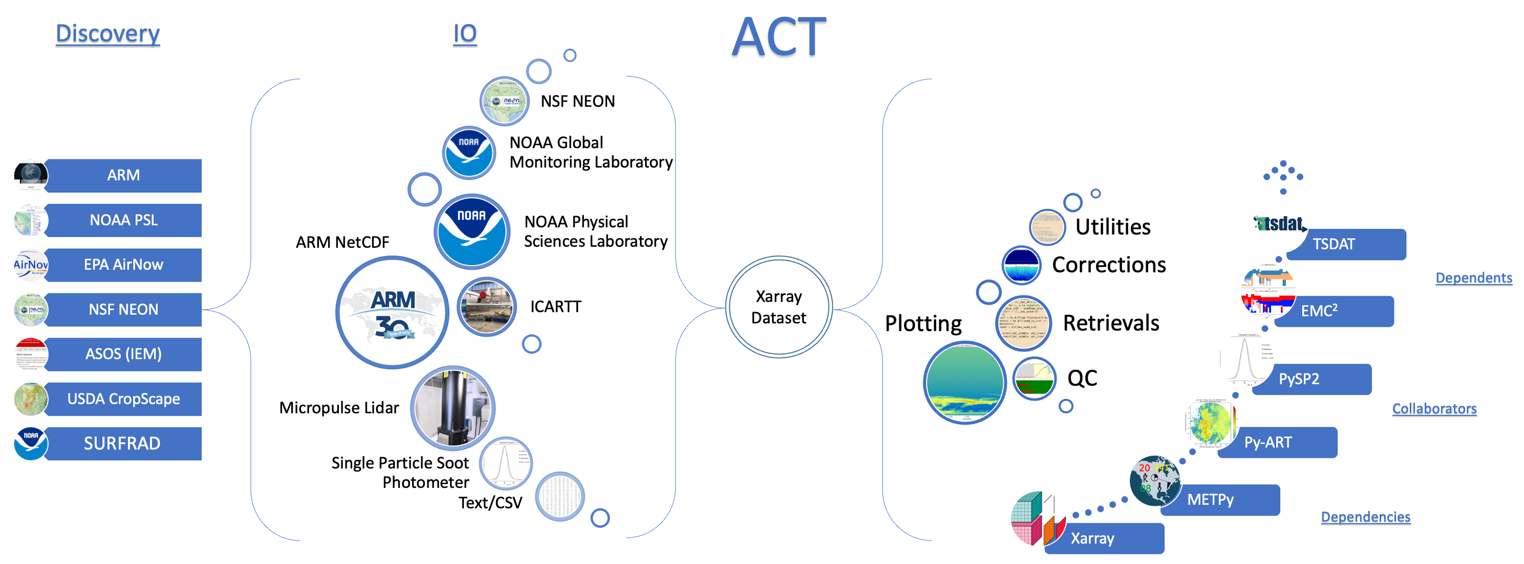
Atmospheric data Community Toolkit (ACT)
Python library for working with time-series data from atmospheric research instrumentation
https://github.com/ARM-DOE/ACT

Slide 3
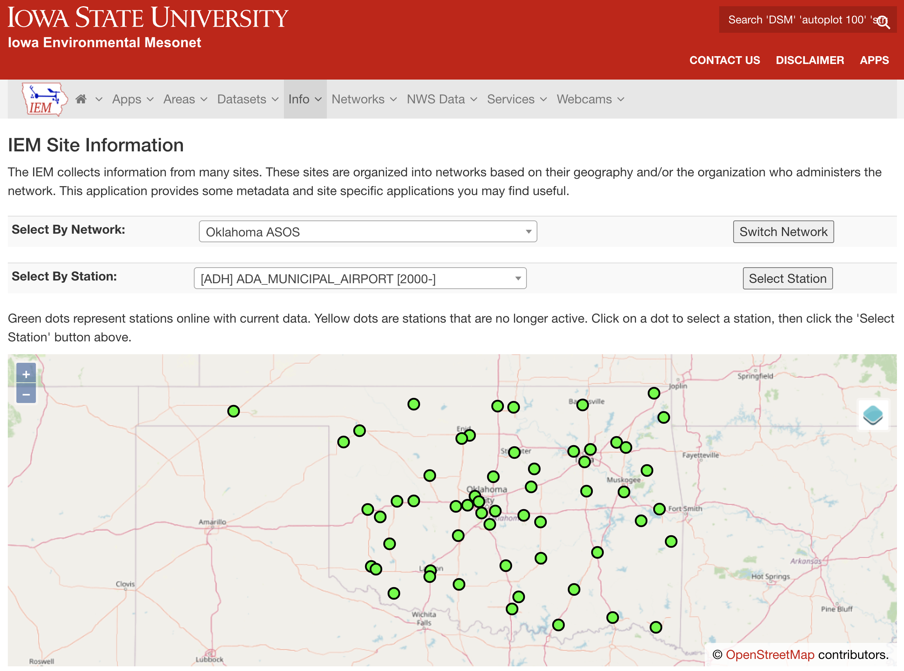
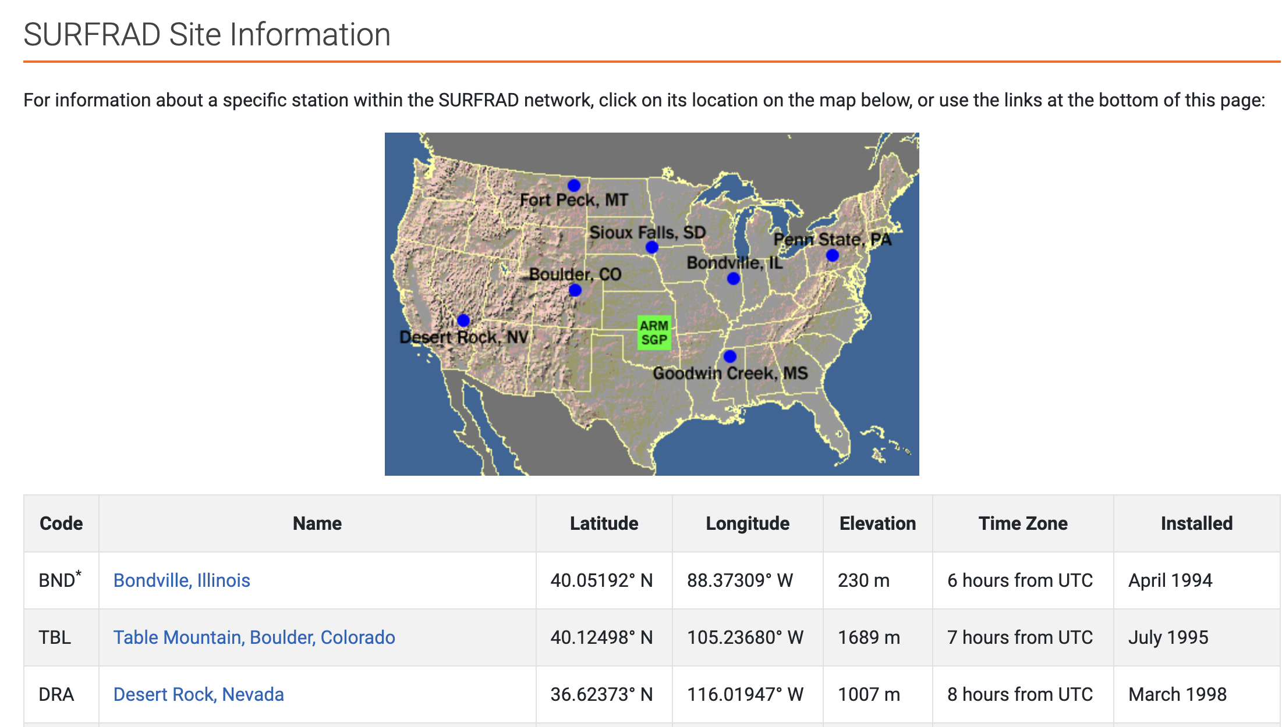
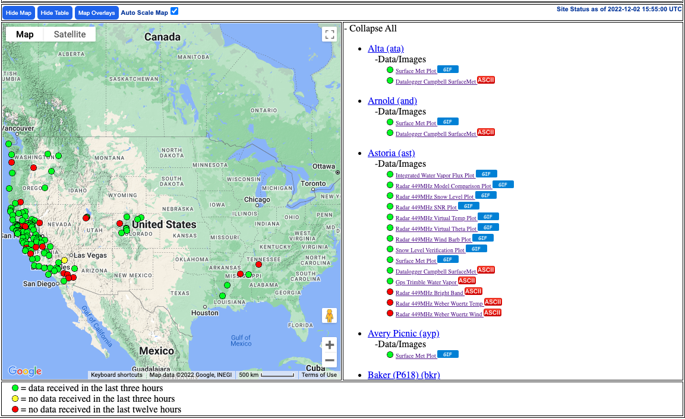
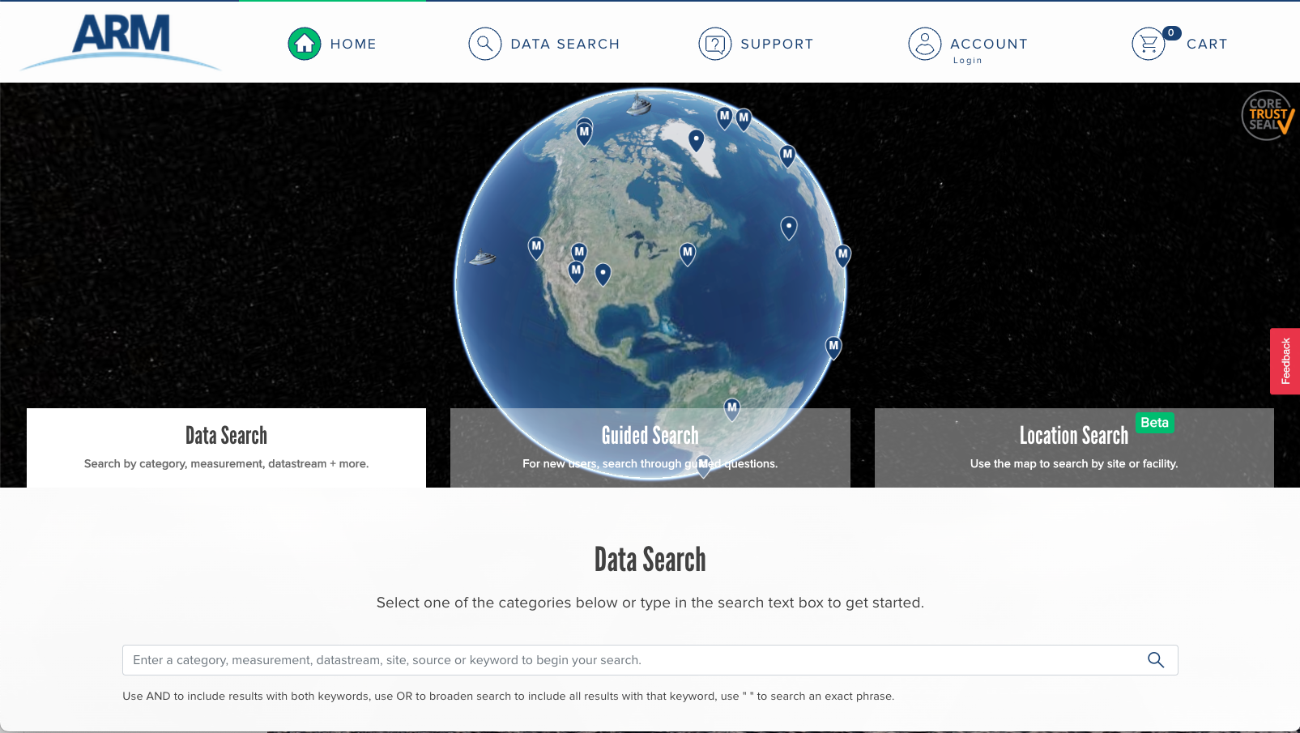
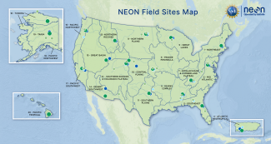
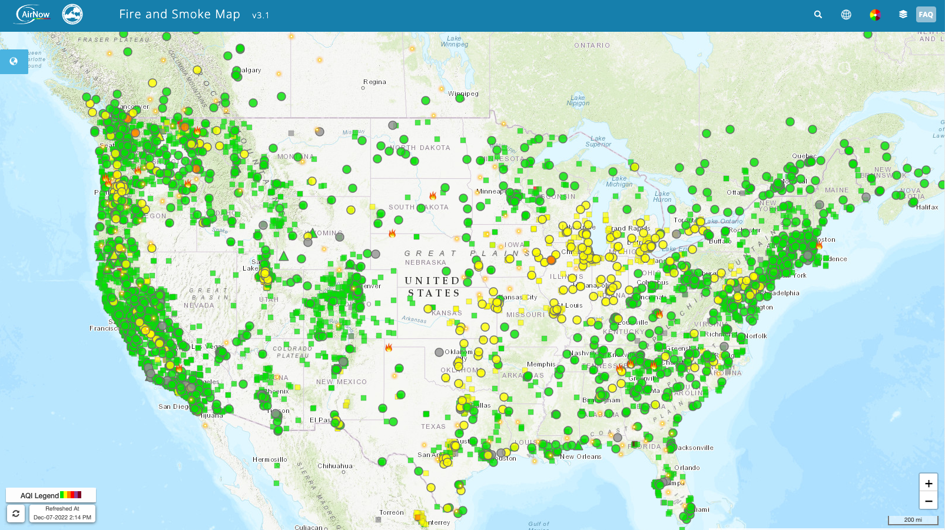
Discovery
ARM’s Live Data Webservice
NOAA’s Physical Sciences Laboratory Profiler Network
NSF’s National Ecological Observatory Network (NEON)
EPA’s AirNow
Automated Surface Observing System (ASOS) Iowa Environmental API
NOAA’s Surface Radiation Budget Network
Images courtesy of respective organizations

Slide 4
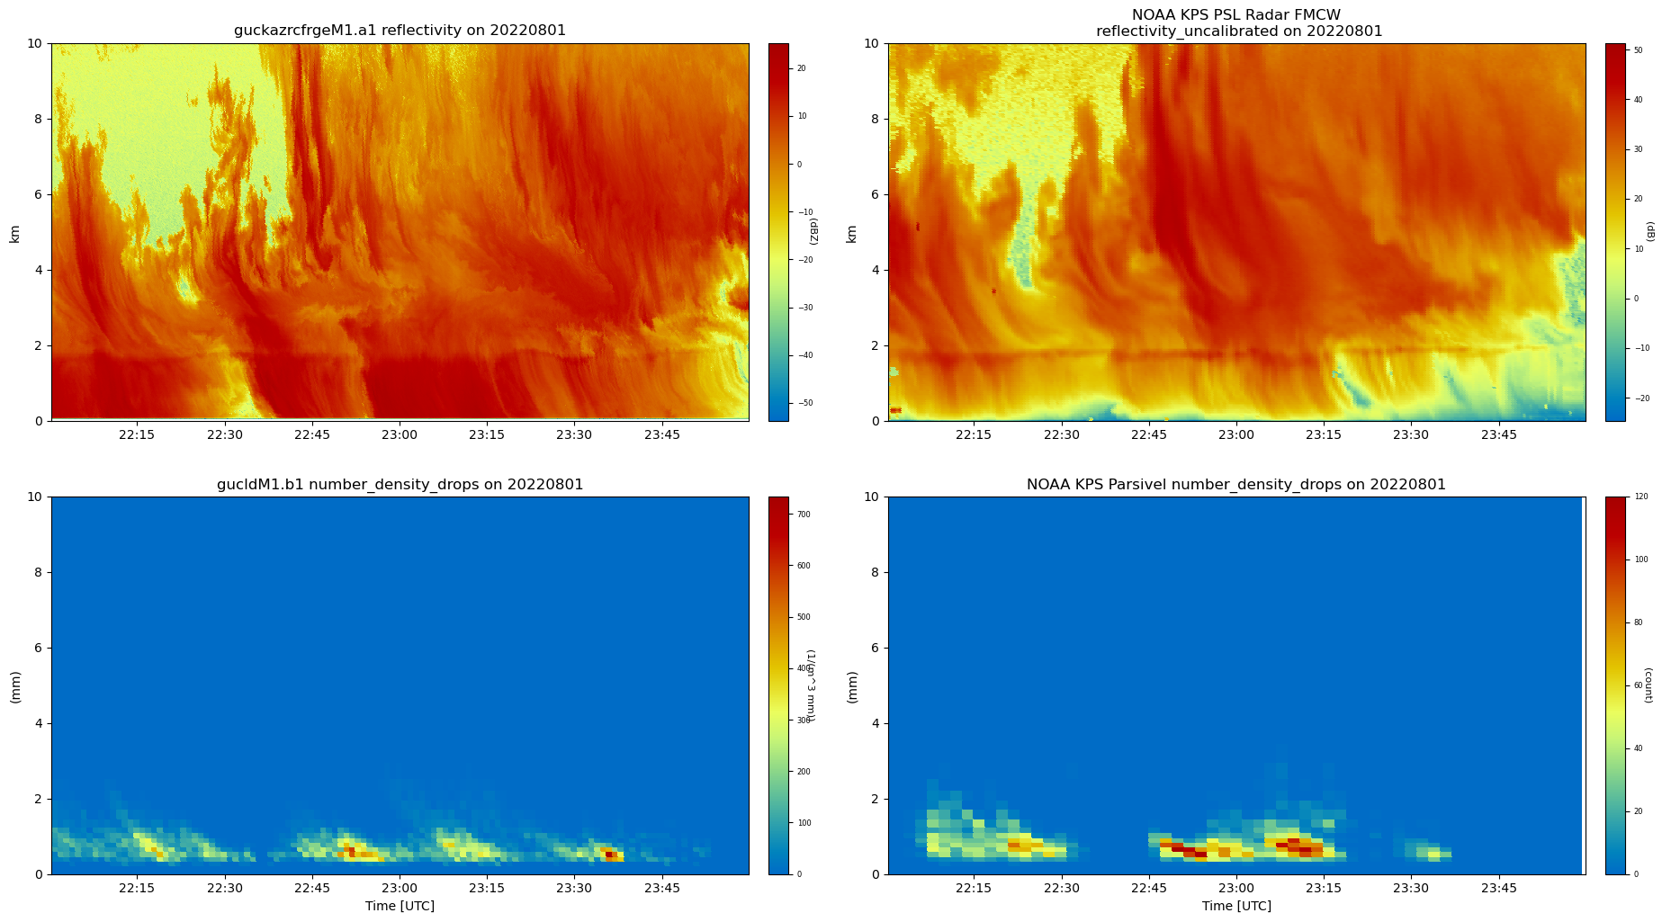
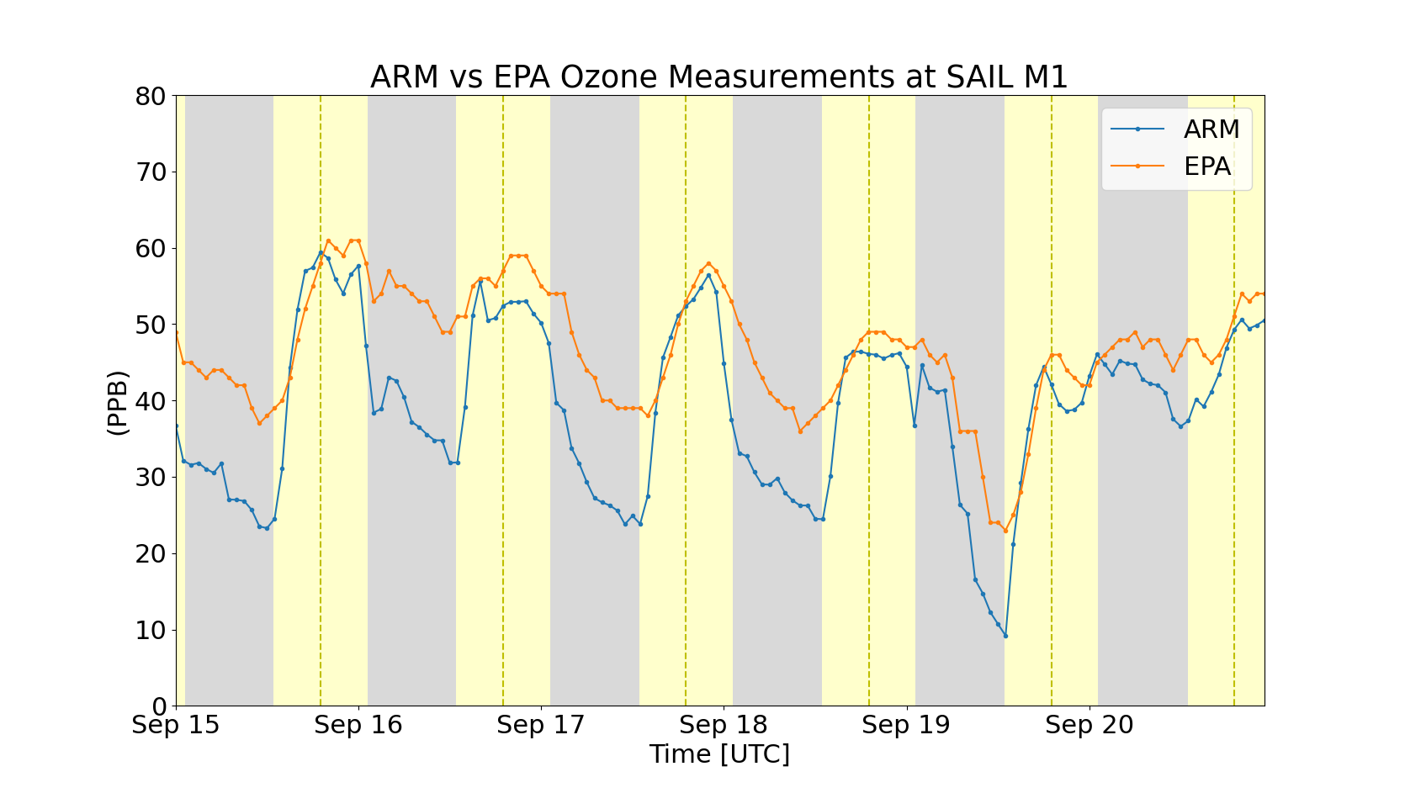
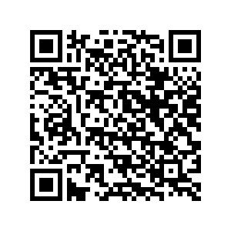
Visualizations
Once data are downloaded and read in to an Xarray Dataset, the rest of the ACT library can easily be used across organizations to explore the data
ARM and NOAA Radar and Disdrometer Data from the SAIL and SPLASH Campaigns in Crested Butte, CO
ARM and EPA Ozone Measurements from Crested Butte, CO
ACT blog post by Zach Sherman

Slide 5
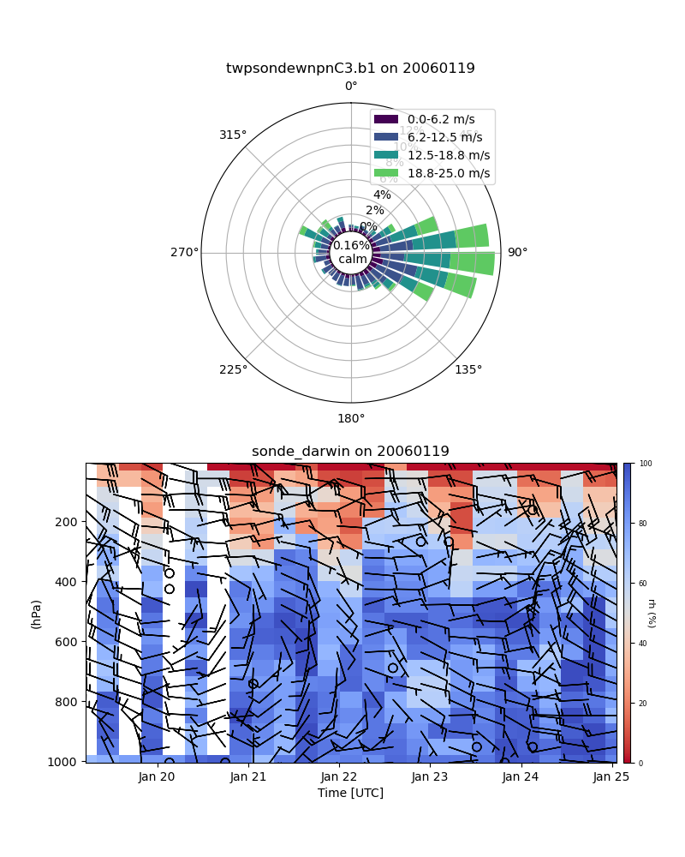
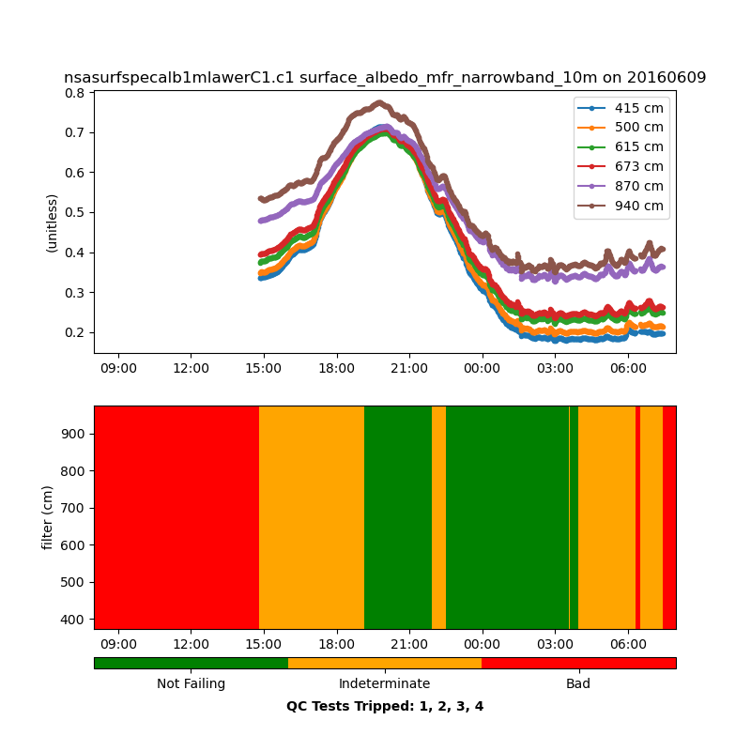
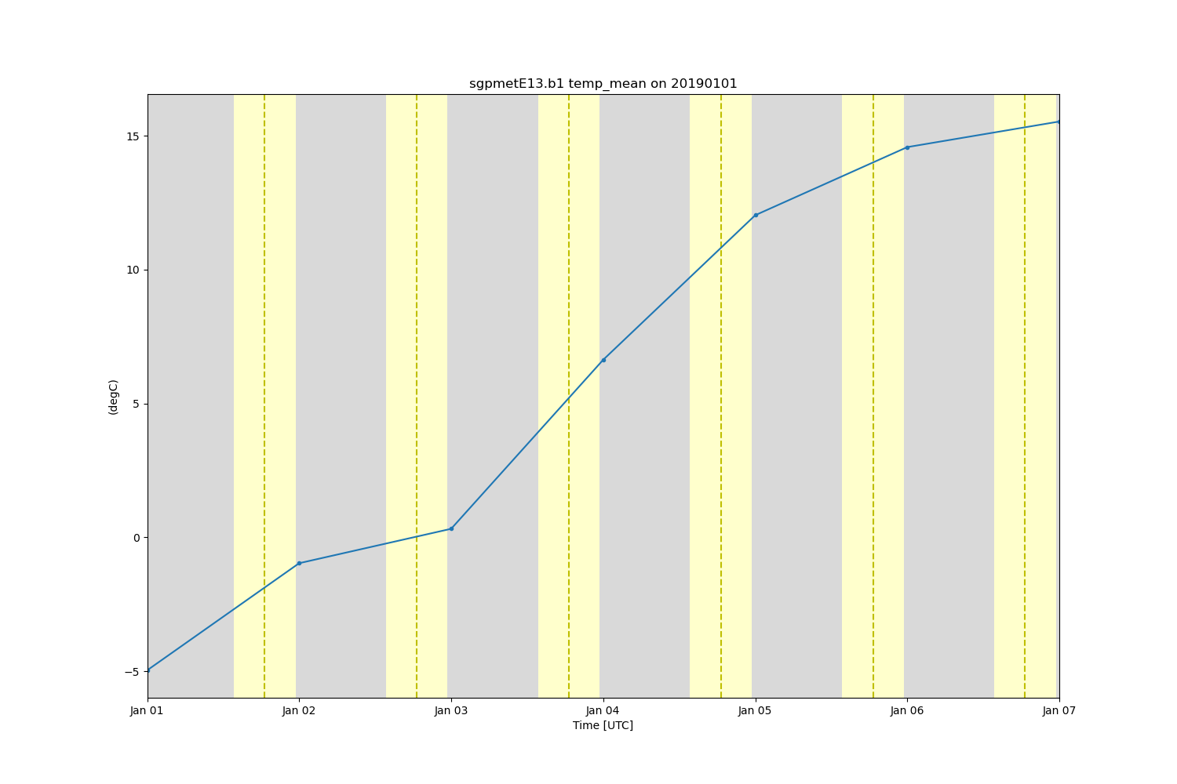
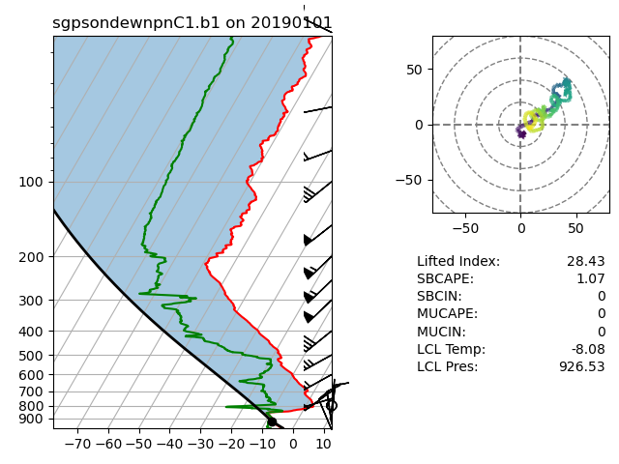
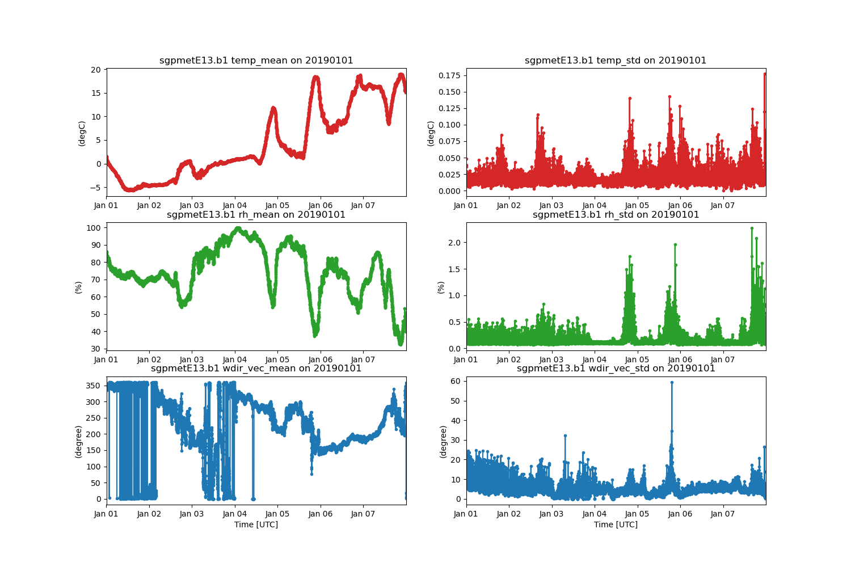
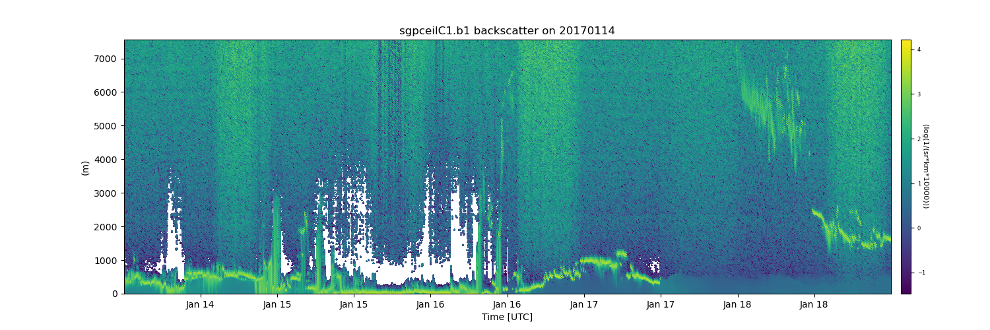
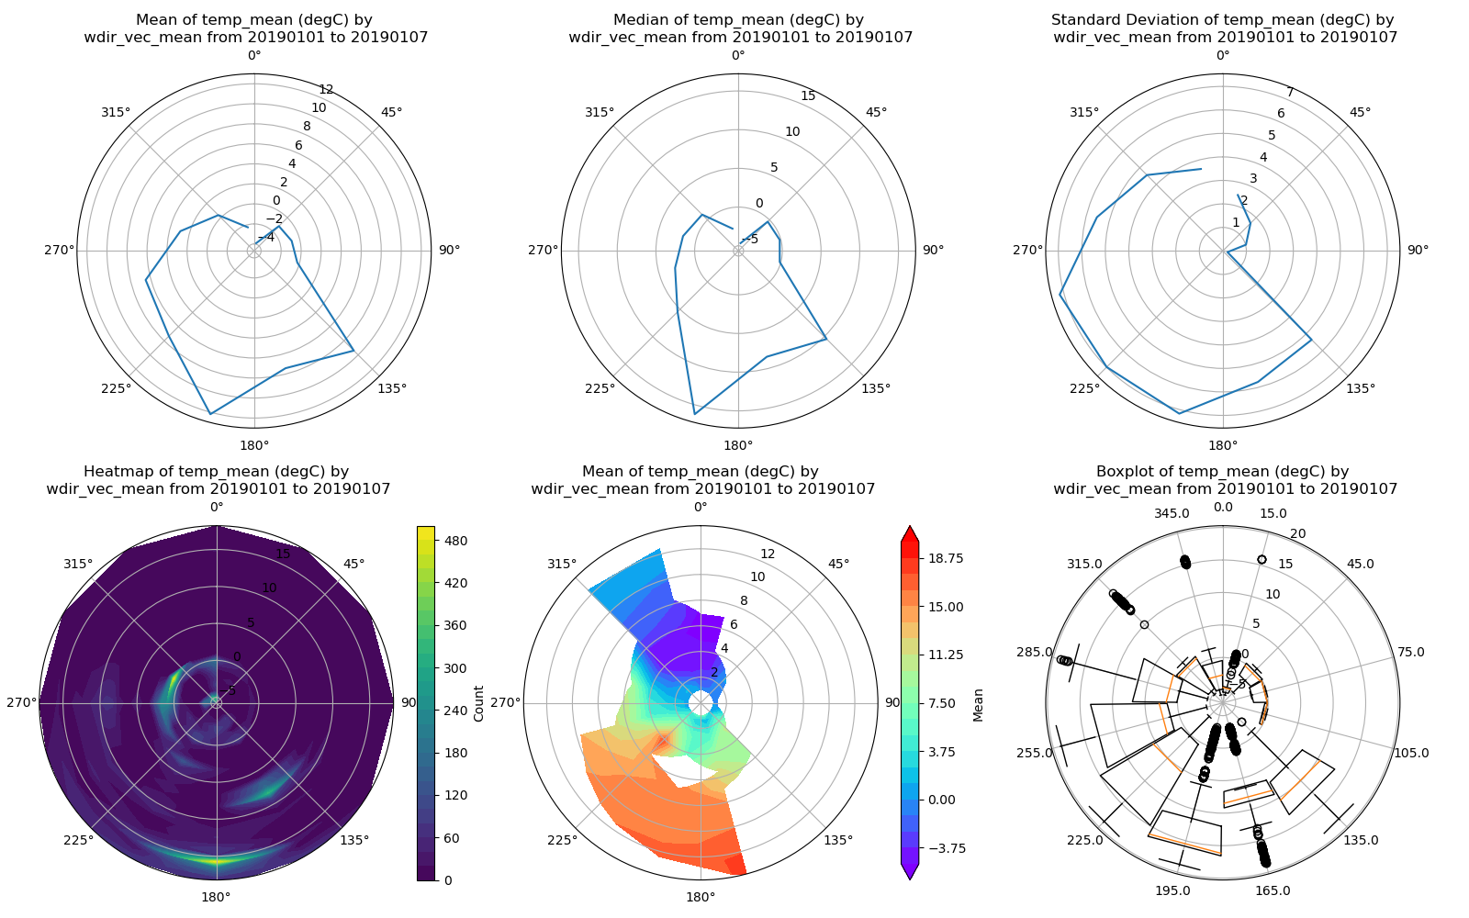
Visualizations

Slide 6
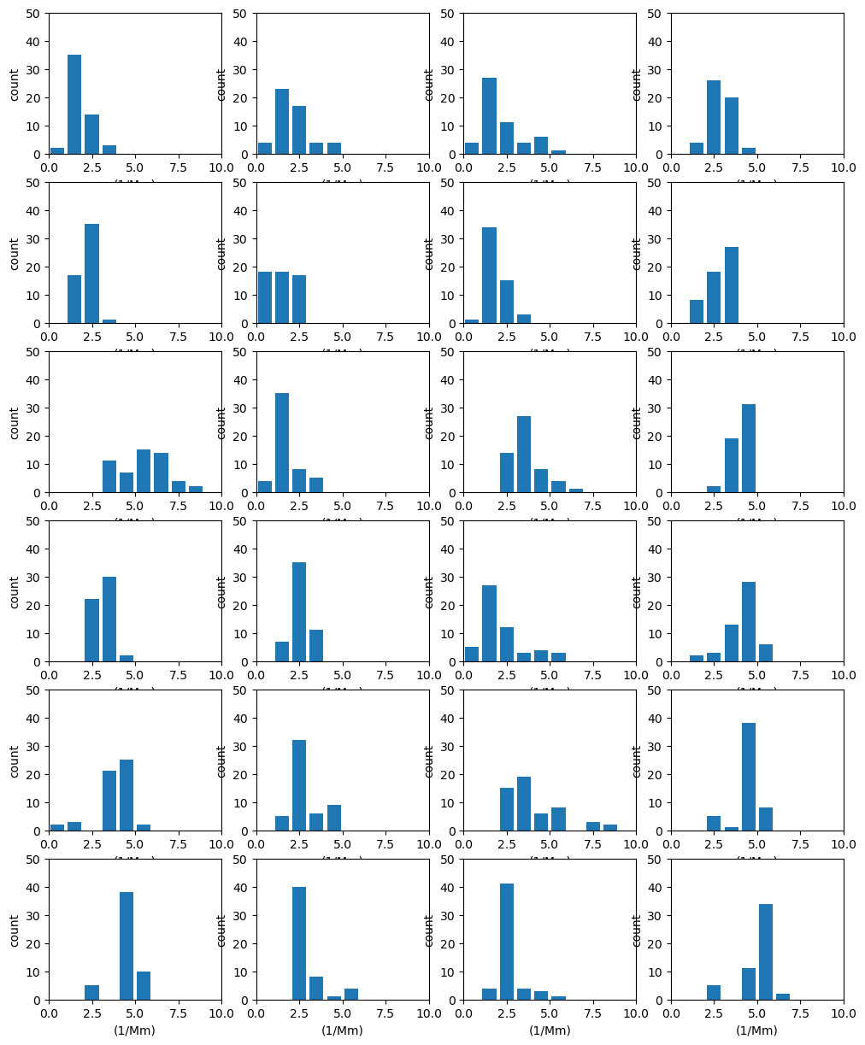
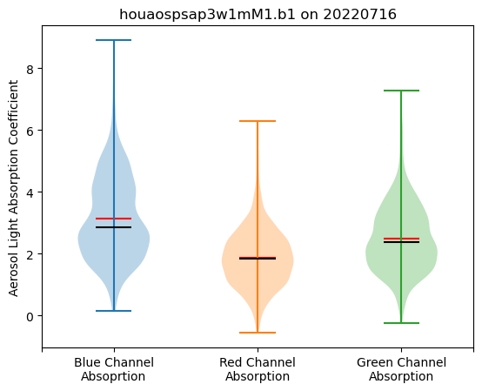
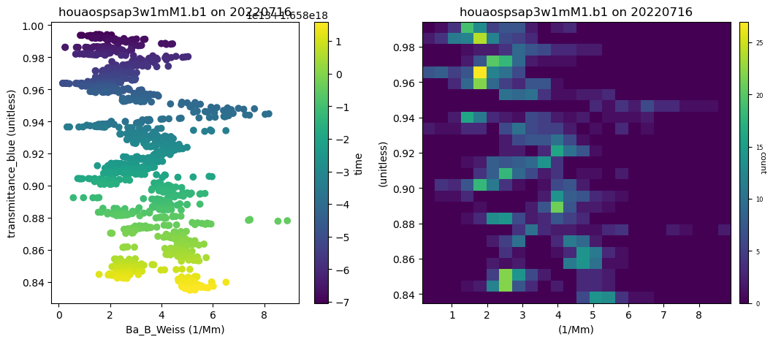
Visualizations – Latest Additions!
Groupby Plots

Slide 7
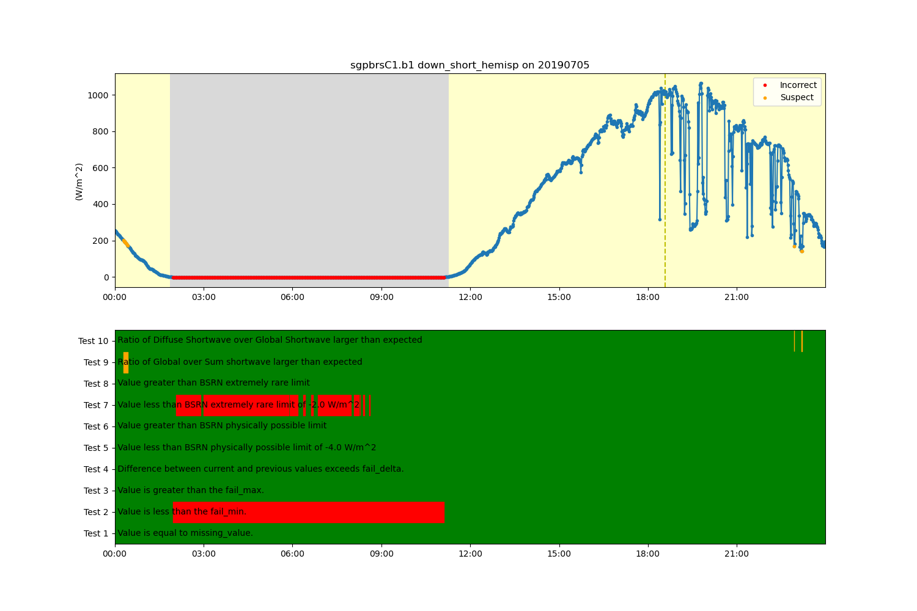
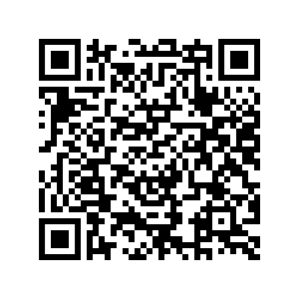
Quality Control
Variety of tests and filtering that can be applied to data in the Dataset
Following CF-standards with bit-packed QC and can be flexible to incorporate other QC methods
Example on applying Baseline Surface Radiation Network (BSRN) quality control
– Ken Kehoe

Slide 8
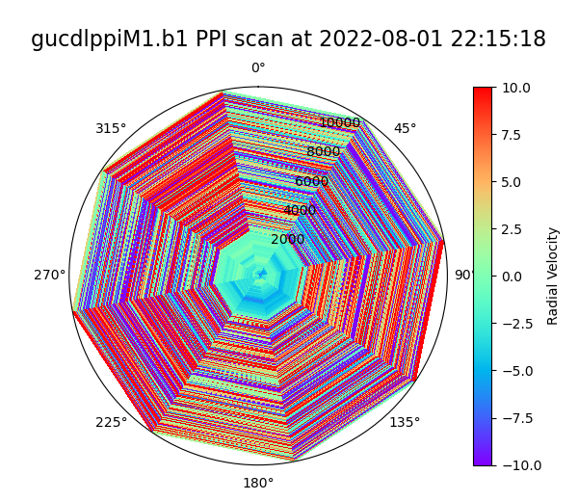
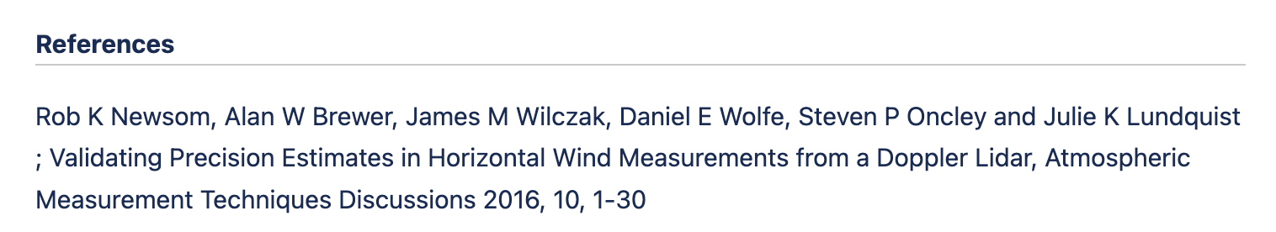
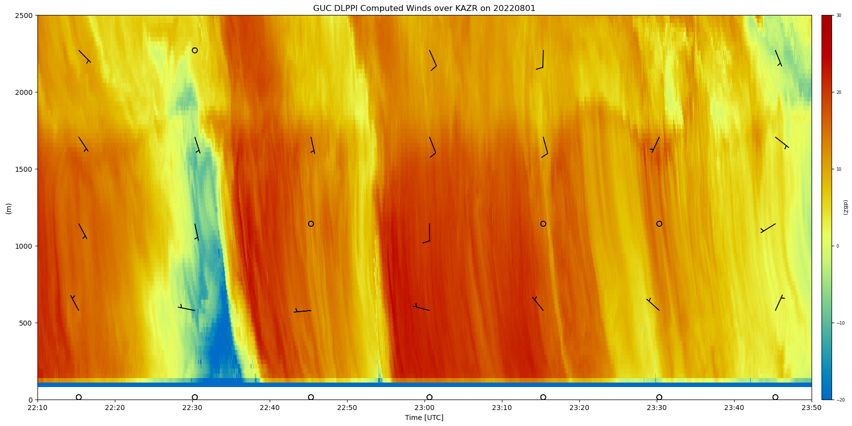
Retrievals
Advanced calculations that would not constitute an individual repository (keep it relatively simple)
Current Examples (subset)
Wind profiles from scanning doppler lidar high elevation PPI scans – Newsom et al. 2016
Planetary boundary layer from radiosondes – Liu and Liang 2010
Sea Surface Temperatures from dual-Infrared Radiometer on a ship
Infrared sky temperature from an Atmospheric Emitted Radiance Interferometer (AERI)
And more!
Doppler Lidar PPI
(Courtesy of ARM DQ Office)

Slide 9
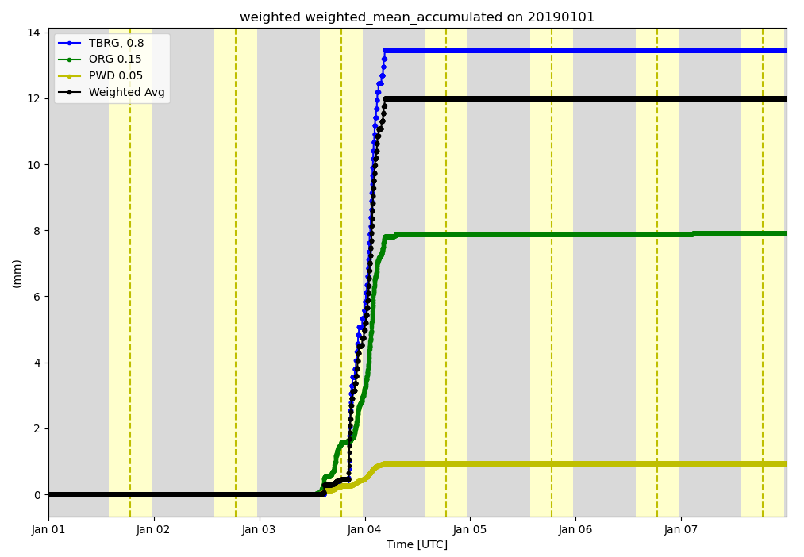
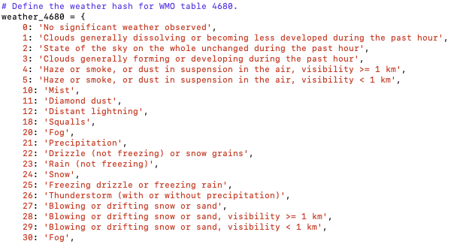
Utilities
General utilizes that don’t fall into the other categories
Precipitation accumulation
Weighted averages
Decode present weather observations
Adding solar variables to denote day, night, dawn, and dusk
Unit conversion
Planck converters
Datetime/ARM time converters
etc…

Slide 10
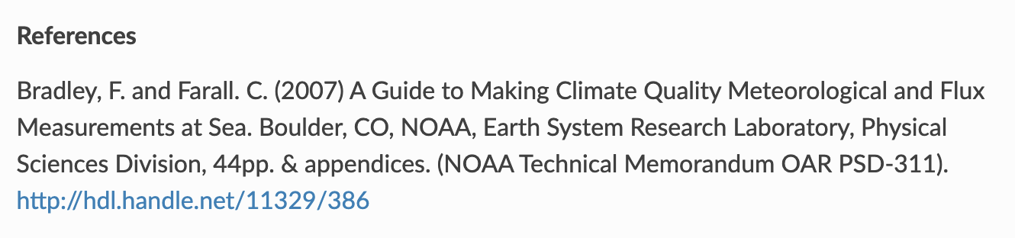
Core Practices
We want to funnel citations to the papers behind the algorithms
Where we have the information, we have a “Reference” section in our documentation that point to the papers or technical reports the code is based on
Contributors get added to the Author list on the DOI
Citation is auto-generated with each new release
Unit test coverage stays above 90%
Vulnerability and antivirus scanning
Adam Theisen, Ken Kehoe, Zach Sherman, Bobby Jackson, Max Grover, Corey Godine, Alyssa J. Sockol, Jason Hemedinger, Joe O'Brien, Jenni Kyrouac, Denny Hackel, & Michael Giansiracusa. (2023). ARM-DOE/ACT: ACT Release v1.5.1 (v1.5.1). Zenodo. https://doi.org/10.5281/zenodo.8117547

Slide 11
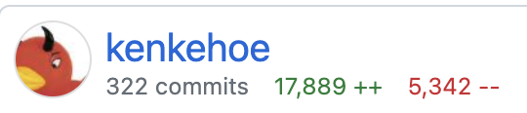
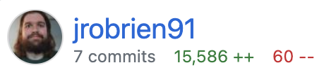
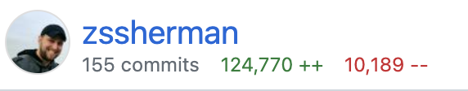
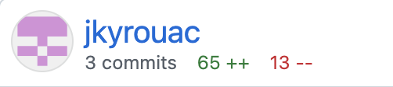
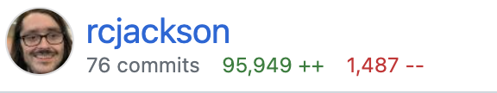
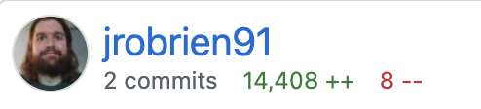
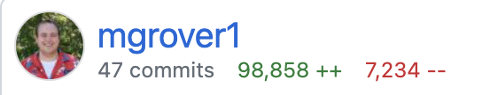
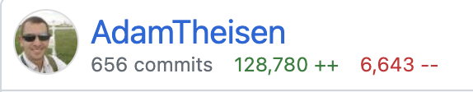
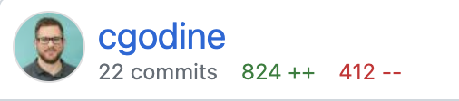
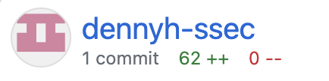
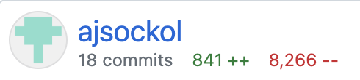
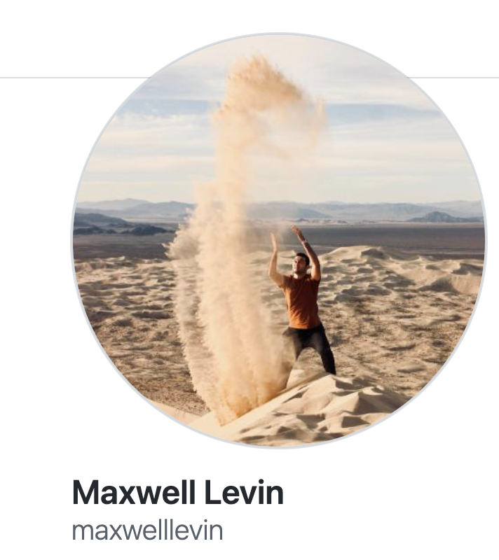
Thank you to the current ACT Contributors
Michael Giansiracusa (Oak Ridge National Laboratory)

Slide 12
Welcome to future ACT contributors!

Slide 13
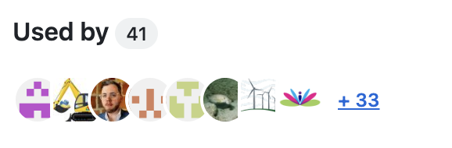
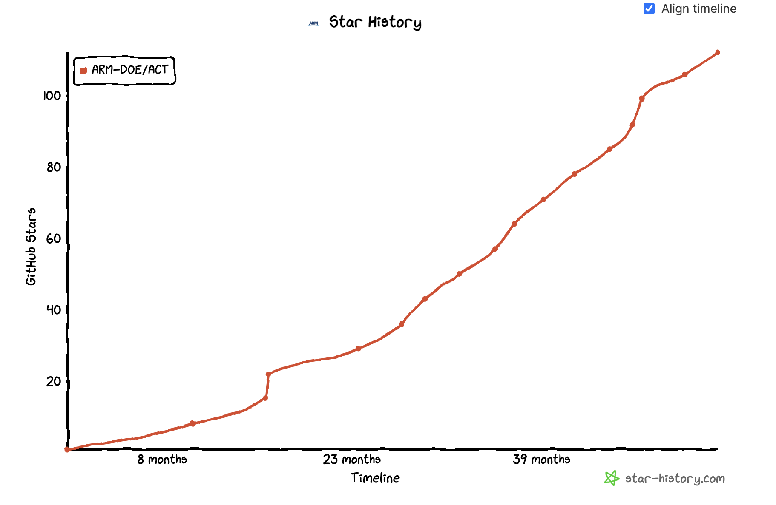
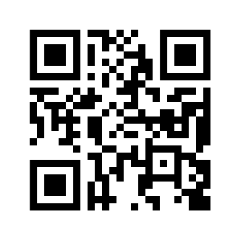
Questions
act-atmos
https://github.com/ARM-DOE/ACT
Image courtesy of star-history.com

